Slide 1
Information Technology Dept.
Welcome to IF3I Course - Object Oriented Programming using C++ Course Code – 22316
Theory Paper – 70 Marks
External Practical – 30 Marks
Term Work – 25 Marks

Slide 2
Curriculum and Course Outcomes
 | Curriculum | Course Outcomes
Ch 1 | Principles of Object Oriented Programming(14) | Develop C++ program using Procedure Oriented Approach
Ch 2 | Classes and Objects(18) | Develop C++ programs using classes and objects
Ch 3 | Extending classes using Inheritance (16) | Implement Inheritance in C++ Programs
Ch 4 | Pointers and Polymorphism in C++(14) | Use Polymorphism in C++ program
Ch 5 | File Operations(8) | Develop C++ programs to perform file operation

Slide 3
Online Editor
https://www.codechef.com/ide
https://www.jdoodle.com/online-compiler-c++/
https://www.w3schools.com/cpp/cpp_compiler.asp
https://www.tutorialspoint.com/compile_cpp_online.php
Etc.

Slide 4
Basic Concept of Object Oriented Programming
6. Polymorphism
5. Inheritance
1. Object
Object Oriented Programming
4. Encapsulation
2. Class
3. Abstraction

Slide 5
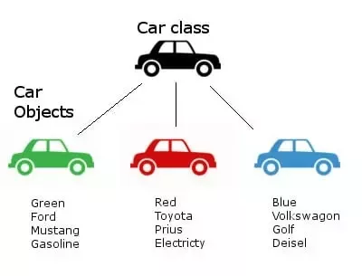
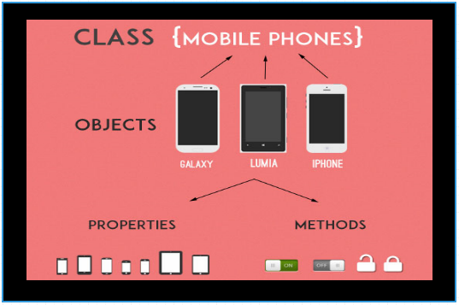
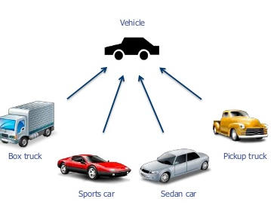
Basic Concept - Object
Objects are the basic unit of OOP.
They are instances of class, which have data members and uses various member functions to perform tasks.

Slide 6
Basic Concept - Class
It is similar to structures in C language.
Class can also be defined as user defined data type but it also contains functions in it.
So, class is basically a blueprint for object.
It declare & defines what data variables the object will have and what operations can be performed on the class's object.

Slide 7

Basic Concept - Abstraction
Abstraction refers to showing only the essential features of the application and hiding the details.
In C++, classes can provide methods to the outside world to access & use the data variables, keeping the variables hidden from direct access.
Example detail functioning of remote control is hidden.

Slide 8
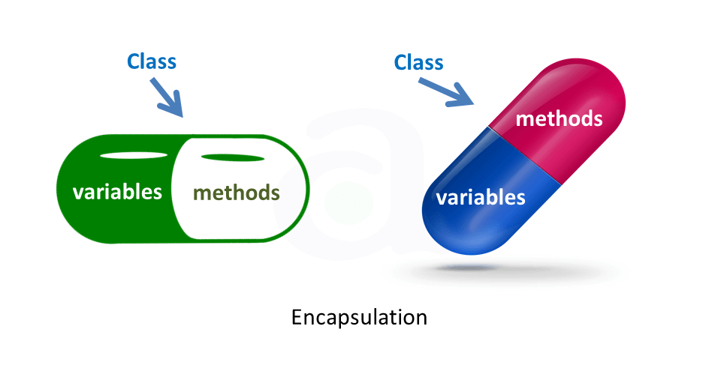
Basic Concept - Encapsulation
Encapsulation is all about binding the data variables and functions together in class.

Slide 9
Basic Concept - Inheritance
Inheritance is a way to reuse once written code again and again.
The class which is inherited is called the Base class & the class which inherits is called the Derived class.
They are also called parent and child class.
So when, a derived class inherits a base class, the derived class can use all the functions which are defined in base class, hence making code reusable.

Slide 10
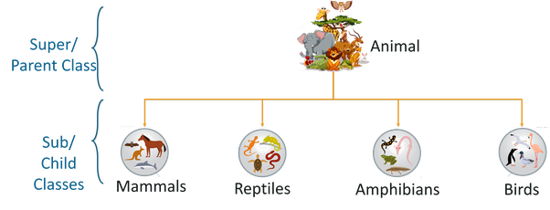
Basic Concept – Inheritance Cont…

Slide 11
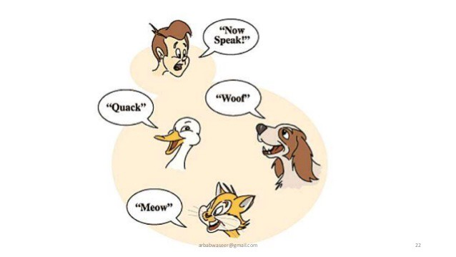
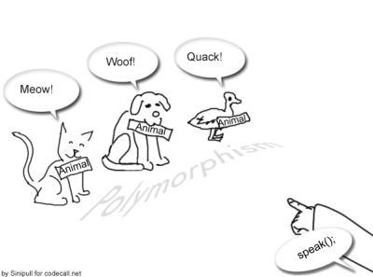
Basic Concept – Polymorphism
It is a feature, which lets us create functions with same name but different arguments, which will perform different actions.
That means, functions with same name, but functioning in different ways.

Slide 12
Overview of OOP Concept
Object – Instance of class
Class – Blue print of Object
Abstraction – Data hiding
Encapsulation – Wrapping up of data and methods in single unit
Inheritance – Reusability
Polymorphism – One name, many forms

Slide 13
OOP Languages
Simula
C++
Java
Python
etc..

Slide 14
Application of OOP
Here Are Some Applications Of Object-Oriented Programming
Client-Server Systems
Object-Oriented Databases
Real-Time System Design
Simulation And Modelling System
Hypertext And Hypermedia
Neural Networking And Parallel Programming
Office Automation Systems

Slide 15
Difference between C and C++
Sr. No. | Key | C | C++
1 | Introduction | C was developed by Dennis Ritchie in around 1969 at AT&T Bell Labs. | C++ was developed by Bjarne Stroustrup in 1979.
2 | Language Type | As mentioned before C is procedural programming. | On the other hand, C++ supports both procedural and object-oriented programming paradigms.
3 | OOPs feature Support | As C does not support the OOPs concept so it has no support for polymorphism, encapsulation, and inheritance. | C++ has support for polymorphism, encapsulation, and inheritance as it is being an object-oriented programming language
4 | Data Security | As C does not support encapsulation so data behave as a free entity and can be manipulated by outside code. | On another hand in the case of C++ encapsulation hides the data to ensure that data structures and operators are used as intended.
5 | Driven type | C in general known as function-driven language. | On the other hand, C++ is known as object driven language.
6 | Feature supported | C does not support function and operator overloading also do not have namespace feature and reference variable functionality. | On the other hand, C++ supports both function and operator overloading also have namespace feature and reference variable functionality.

Slide 16
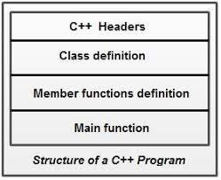
Structure of C++ Program
#include <iostream.h>
#include<conio.h>
class Student
{
int rollno;
char name[10];
void get();
void put();
};
void main()
{
…
…
}

Slide 17
Simple C++ Program
#include<iostream.h>
#include<conio.h>
int main()
{
cout << “Hello World”;
return 0;
}
Let’s try program on
https://www.codechef.com/ide
Header
Main Function

Slide 18
Tokens
A token is the smallest element of a program that is meaningful to the compiler. Tokens can be classified as follows:
Keywords
Identifiers
Constants
Strings
Special Symbols
Operators

Slide 19
Token - Keyword
Keywords are pre-defined or reserved words in a programming language. Each keyword is meant to perform a specific function in a program. Since keywords are referred names for a compiler, they can’t be used as variable names
You cannot redefine keywords.
C language supports 32 keywords
C++ there are 31 additional keywords other than C Keywords

Slide 20
C Keywords
auto | double | int | struct
break | else | long | switch
case | enum | register | typedef
char | extern | return | union
const | float | short | unsigned
continue | for | signed | void
default | goto | sizeof | volatile
do | if | static | while

Slide 21
C++ Keywords
asm | bool | catch | Class
const_cast | delete | dynamic_cast | explicit
export | false | friend | inline
mutable | namespace | new | operator
private | protected | public | reinterpret_cast
static_cast | template | this | throw
true | try | typeid | typename
using | virtual | wchar_t

Slide 22
Identifiers
Identifiers are used as the general terminology for naming of variables, functions and arrays.
These are user defined names consisting of arbitrarily long sequence of letters and digits with either a letter or the underscore(_) as a first character.
You cannot use keywords as identifiers; they are reserved for special use.

Slide 23
Identifiers Cont…
There are certain rules that should be followed while naming c identifiers:
They must begin with a letter or underscore(_).
They must consist of only letters, digits, or underscore. No other special character is allowed.
It should not be a keyword.
It must not contain white space.
It should be up to 31 characters long as only first 31 characters are significant.

Slide 24
Identifier Examples
Valid Identifiers
_A9
add
Invalid Identifiers
Temp.var
void

Slide 25
Token - Constant
Constants are also like normal variables. But, only difference is, their values can not be modified by the program once they are defined.
Constants refer to fixed values.
They are also called as literals.
Constants may belong to any of the data type

Slide 26
Token Example
#include<iostream.h>
void main()
{
int a = 5;
const int var_const = 50;
cout << “ Variable a = “ << a;
cout << “Constant = “ << var_const;
}
Let’s try program on
https://www.codechef.com/ide

Slide 27
Token Example Cont…
#include<iostream.h>
void main()
{
int a = 5;
const int var_const = 50;
cout << “ Variable a = “ << a;
cout << “Constant = “ << var_const;
var_const = 55; // error
}

Slide 28
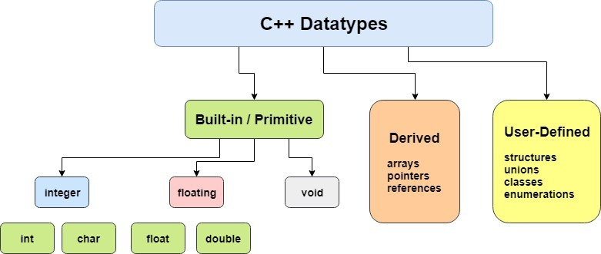
Basic Datatypes

Slide 29
Basic Datatypes Cont…
Type | Width | Range
char | 1byte | Signed char-127 to 127 Unsigned Char- 0 to 255
short int | 2 bytes | signed: -32768 to 32767 unsigned: 0 to 65535
int | 4 bytes | signed: -2147483648 to 2147483647 unsigned: 0 to 4294967295
long int | 4 bytes | signed: -2147483648 to 2147483647 unsigned: 0 to 4294967295
bool | 1byte | true or false
float | 4bytes | +/- 3.4e +/- 38 (~7 digits)
double | 8bytes | +/- 1.7e +/- 308 (~15 digits)
long double | 8bytes | +/- 1.7e +/- 308 (~15 digits)

Slide 30
Basic Datatypes Cont…
Declaration of variables :
//Declaring a variable
Datatype identifier;
E.g
int a;
float b;
//Declaring and initializing variable.
Datatype identifier = value;
E.g.
int a = 5;
Float b = 5.5f;

Slide 31
Scope of Variable
A variable can be either of global or local scope.
A global variable is a variable declared in the main body of the source code, outside all functions.
A local variable is one declared within the body of a function or a block.
E.g.
#include<iostream.h>
int a=5;
int main()
{
int b = 6;
}
Global Variable
Local Variable

Slide 32
User defined Data types

Slide 33
Typecasting
A type cast is basically a conversion from one type to another.
There are two types of type conversion:
Impicit typecasting
Explicit typecasting
Implicit Type Conversion Also known as ‘automatic type conversion’.
Done by the compiler on its own.
Generally takes place when in an expression more than one data type is present.
All the data types of the variables are upgraded to the data type of the variable with largest data type.
bool -> char -> short int -> int -> unsigned int -> long -> unsigned long -> float -> double -> long double

Slide 34
Typecasting - Implicit type casting example
#include <iostream>
using namespace std;
int main()
{
int x = 10; // integer x
char y = 'a'; // character c
// y implicitly converted to int. ASCII
// value of 'a' is 97
x = x + y;
// x is implicitly converted to float
float z = x + 1.0;
cout << "x = " << x << endl
<< "y = " << y << endl
<< "z = " << z << endl;
return 0;
}

Slide 35
Typecasting - Explicit type casting
This process is also called type casting and it is user-defined.
Here the user can typecast the result to make it of a particular data type.
This is done by explicitly defining the required type in front of the expression in parenthesis. This can be also considered as forceful casting.
Syntax: (type) expression
where type indicates the data type to which the final result is converted.

Slide 36
Typecasting - Explicit type casting example
#include <iostream>
using namespace std;
int main()
{
double x = 1.2;
// Explicit conversion from double to int
int sum = (int)x + 1;
cout << "Sum = " << sum;
return 0;
}

Slide 37
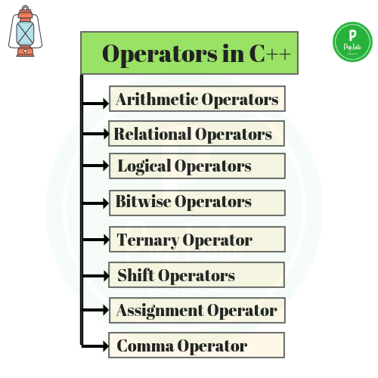
Operators in C++

Slide 38
Operators - Assignment Operator
The assignment operator assigns a value to a variable.
X = 5;
The assignment operation always takes place from right to left.

Slide 39
Operators – Arithmetic Operators
operator | description
+ | addition
- | subtraction
* | multiplication
/ | division
% | Modulo
+=
-=
*=
/=
++
--
Operations of addition, subtraction, multiplication and division correspond literally to their respective mathematical operators. The last one, modulo operator, represented by a percentage sign (%), gives the remainder of a division of two values.

Slide 40
Operators – Relational Operators
operator | description
== | Equal to
!= | Not equal to
< | Less than
> | Greater than
<= | Less than or equal to
>= | Greater than or equal to

Slide 41
Operators – Logical Operators
operator | short-circuit
!
&& | if the left-hand side expression is false, the combined result is false (the right-hand side expression is never evaluated).
|| | if the left-hand side expression is true, the combined result is true (the right-hand side expression is never evaluated).

Slide 42
Operators – Ternary Operators
? :
The conditional operator evaluates an expression, returning one value if that expression evaluates to true, and a different one if the expression evaluates as false. Its syntax is: condition ? result1 : result2
E.g
7==5 ? 4 : 3
7==5+2 ? 4 : 3
5>3 ? a : b
a>b ? a : b

Slide 43
Operators – Bitwise Operators
operator | asm equivalent | description
& | AND | Bitwise AND | (A & B) will give 12 which is 0000 1100
| | OR | Bitwise inclusive OR | (A | B) will give 61 which is 0011 1101
^ | XOR | Bitwise exclusive OR | (A ^ B) will give 49 which is 0011 0001
~ | NOT | Unary complement (bit inversion) | ~A ) will give -61 which is 1100 0011 in 2's complement form due to a signed binary number.
Assume if A = 60; and B = 13; now in binary format they will be as follows −
A = 0011 1100
B = 0000 1101

Slide 44
Operators – Shift Operators
operator | asm equivalent | description
<< | SHL | Shift bits left | A << 2 will give 240 which is 1111 0000
>> | SHR | Shift bits right | A >> 2 will give 15 which is 0000 1111

Slide 45
Operators – Comma Operator
The comma operator (,) is used to separate two or more expressions that are included where only one expression is expected.
E.g.
a = (b = 3, b+2)
a is assigned to 5.
Assume if A = 60; now in binary format they will be as follows −
A = 0011 1100

Slide 46
Operator Precedance
ategory | Operator | Associativity
Postfix | () [] -> . ++ - - | Left to right
Unary | + - ! ~ ++ - - (type)* & sizeof | Right to left
Multiplicative | * / % | Left to right
Additive | + - | Left to right
Shift | << >> | Left to right
Relational | < <= > >= | Left to right
Equality | == != | Left to right
Bitwise AND | & | Left to right
Bitwise XOR | ^ | Left to right
Bitwise OR | | | Left to right
Logical AND | && | Left to right
Logical OR | || | Left to right
Conditional | ?: | Right to left
Assignment | = += -= *= /= %=>>= <<= &= ^= |= | Right to left
Comma | , | Left to right

Slide 47
Scope resolution Operator (::)
The :: (scope resolution) operator is used to get hidden names due to variable scopes so that you can still use them.
For example, if you have a global variable of name my_var and a local variable of name my_var, to access global my_var, you'll need to use the scope resolution operator.
#include <iostream>
using namespace std;
int my_var = 0;
int main(void) {
int my_var = 0;
::my_var = 1; // set global my_var to 1
my_var = 2; // set local my_var to 2
cout << ::my_var << ", " << my_var;
return 0;
}

Slide 48
memory management operator new, delete
Dynamic memory allocation in C/C++ refers to performing memory allocation manually by programmer.
C++ supports these functions and also has two operators new and delete that perform the task of allocating and freeing the memory in a better and easier way.
The new operator denotes a request for memory allocation on the Free Store. If sufficient memory is available, new operator initializes the memory and returns the address of the newly allocated and initialized memory to the pointer variable.
Syntax to use new operator: To allocate memory of any data type,
pointer-variable = new data-type;
int *p = new int;
delete operator
Since it is programmer’s responsibility to deallocate dynamically allocated memory, programmers are provided delete operator by C++ language.
delete pointer-variable;
delete p;

Slide 49
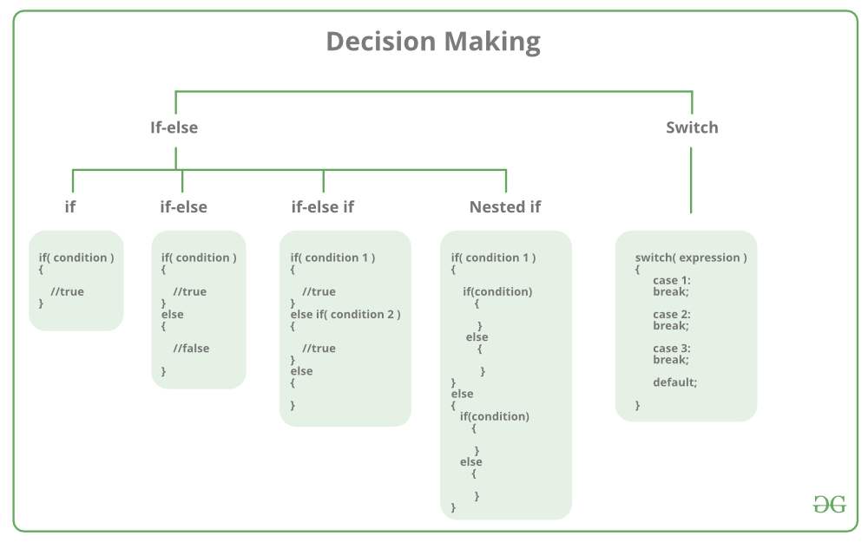
Control Structures: Decision making statements

Slide 50
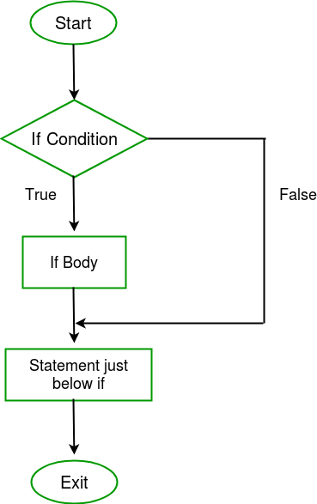
Control Structures: Decision making statements - if
int main() {
int i = 10;
if (i > 15)
{
printf("10 is less than 15");
}
printf("I am Not in if");
}

Slide 51
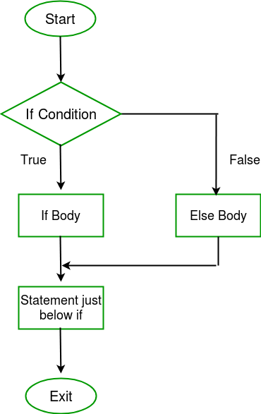
Control Structures: Decision making statements – if - else
int main() {
int i = 20;
if (i < 15)
printf("i is smaller than 15");
else
printf("i is greater than 15");
return 0;
}

Slide 52
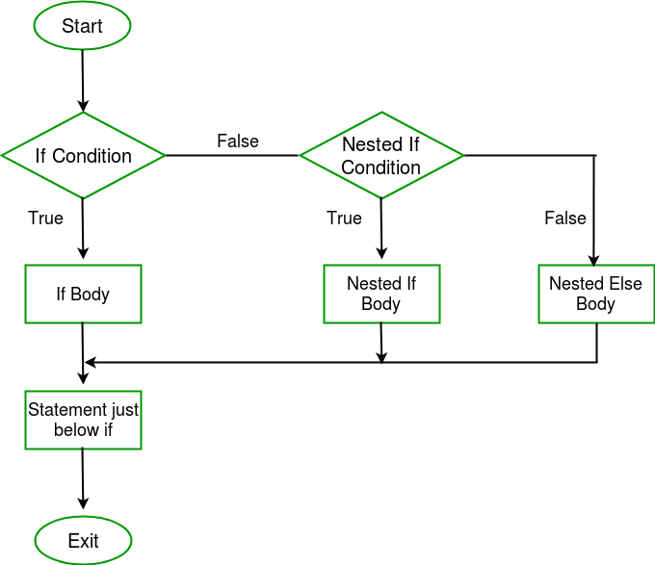
Control Structures: Decision making statements – nested if - else
int main() {
int i = 10;
if (i == 10)
{
if (i < 15)
printf("i is smaller than 15\n");
if (i < 12)
printf("i is smaller than 12 too\n");
else
printf("i is greater than 15");
}
return 0;
}

Slide 53
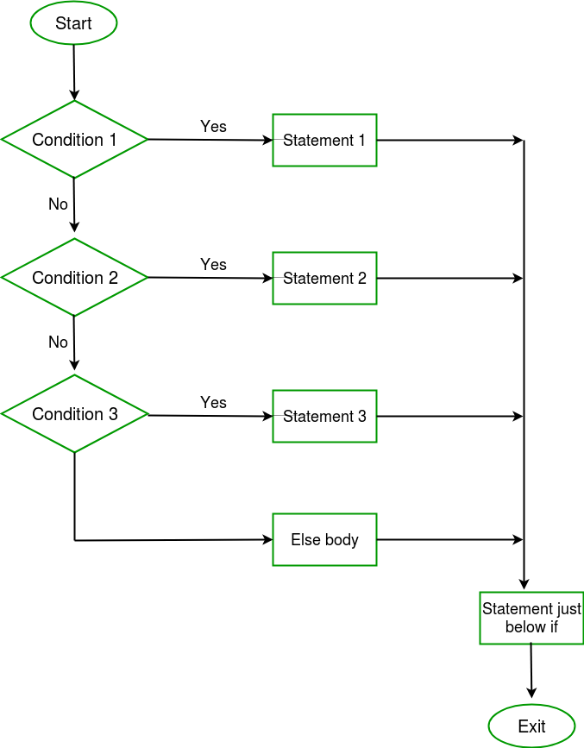
Control Structures: Decision making statements – if – else - if
int main() {
int i = 20;
if (i == 10) // condition 1
printf("i is 10");
else if (i == 15) // cond 2
printf("i is 15");
else if (i == 20) // cond 3
printf("i is 20");
else
printf("i is not present");
}

Slide 54
Control Structures: Decision making statements – Switch
int main()
{
int x = 2;
switch (x)
{
case 1: printf("Choice is 1");
break;
case 2: printf("Choice is 2");
break;
case 3: printf("Choice is 3");
break;
default: printf("Choice other than 1, 2 and 3");
break;
}
return 0;
}

Slide 55
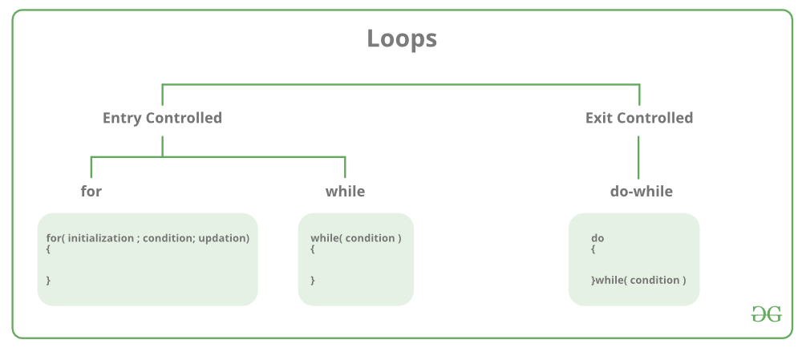
Control Structures: Loop
Loops in programming come into use when we need to repeatedly execute a block of statements.

Slide 56
Control Structures: Loop – for loop
A for loop is a repetition control structure which allows us to write a loop that is executed a specific number of times.
for (initialization expr; test expr; update expr)
{ // body of the loop
// statements we want to execute
}

Slide 57
Control Structures: Loop – for loop
int main()
{
int i=0;
for (i = 1; i <= 10; i++)
{
printf( "Hello World\n");
}
return 0;
}

Slide 58
Control Structures: Loop – while loop
While studying for loop the number of iterations is known beforehand, i.e. the number of times the loop body is needed to be executed is known to us.
while loops are used in situations where we do not know the exact number of iterations of loop beforehand.
The loop execution is terminated on the basis of test condition.
initialization expression;
while (test_expression)
{ // statements
update_expression;
}

Slide 59
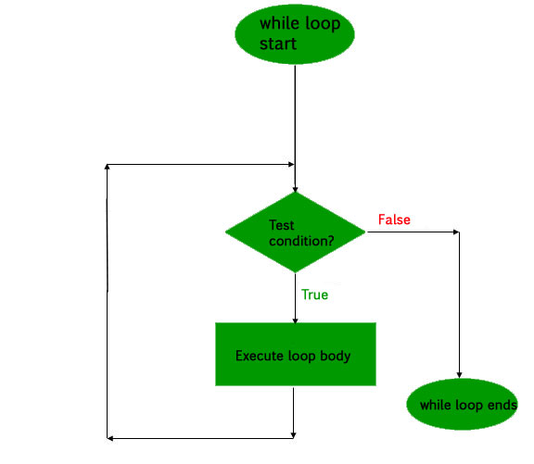
Control Structures: Loop – while loop
int main()
{
// initialization expression
int i = 1;
// test expression
while (i < 6)
{
printf( "Hello World\n");
// update expression
i++;
}
return 0;
}

Slide 60
Control Structures: Loop – do -while loop
In do while loops also the loop execution is terminated on the basis of test condition.
The main difference between do while loop and while loop is in do while loop the condition is tested at the end of loop body,
do while loop is exit controlled whereas the other two loops are entry controlled loops.
initialization expression;
do {
// statements
update_expression;
} while (test_expression);

Slide 61
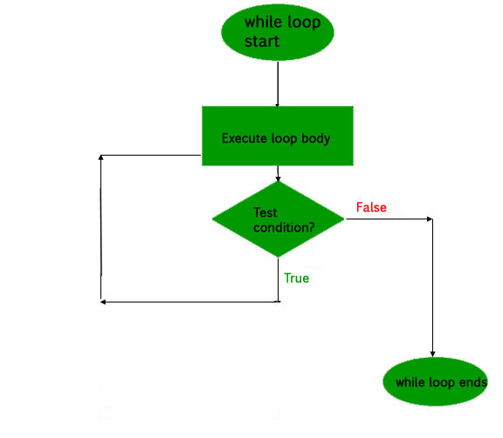
Control Structures: Loop – do -while loop
int main()
{
int i = 2; // Initialization expression
do
{
// loop body
printf( "Hello World\n");
// update expression
i++;
} while (i < 1); // test expression
return 0;
}

Slide 62
Arrays

Slide 63
Array
Array stores a fixed-size sequential collection of elements of the same type.
An array is used to store a collection of data, but it is often more useful to think of an array as a collection of variables of the same type.
A specific element in an array is accessed by an index.
All arrays consist of contiguous memory locations
The lowest address corresponds to the first element and the highest address to the last element.

Slide 64
Declaring and Initializing an Array
Syntax
type arrayName [ arraySize ];
This is called a single-dimension array. The arraySize must be an integer constant greater than zero and type can be any valid C++ data type.
E.g.
double bal[10];
initialize C++ array elements either one by one or using a single statement
E.g
double balance[5] = {1000.0, 2.0, 3.4, 17.0, 50.0};
double balance[] = {1000.0, 2.0};

Slide 65

Accessing Array Elements
double salary = balance[9];
1000
2001

Slide 66
Example
int main () {
int n[ 10 ];
for ( int i = 0; i <=9; i++ ) {
n[ i ] = i ;
}
cout << "Element" << "Value" << endl;
for ( int j = 0; j < 10; j++ ) {
cout << j << n[ j ] << endl;
}
return 0;
}

Slide 67
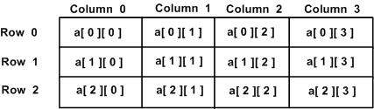
Multidimensional array
Syntax -
type name[size1][size2]...[sizeN];
Example
Two Dimensional Array –
11 | 12 | 13 | 14
15 | 16 | 17 | 18
19 | 20 | 21 | 22

Slide 68
Two Dimensional Array
Syntax-
type arrayName [ x ][ y ];
Where type can be any valid C++ data type and arrayName will be a valid C++ identifier.
A two-dimensional array can be think as a table, which will have x number of rows and y number of columns.

Slide 69
Initializing and Accessing two dimensional array
int a[3][4] = { {0, 1, 2, 3} ,
{4, 5, 6, 7} ,
{8, 9, 10, 11}
};
int a[3][4] = {0,1,2,3,4,5,6,7,8,9,10,11};

Slide 70
Example
int main () {
int a[5][2] = { {0,0}, {1,2}, {2,4}, {3,6},{4,8}};
for ( int i = 0; i < 5; i++ )
for ( int j = 0; j < 2; j++ ) {
cout << "a[" << i << "][" << j << "]: ";
cout << a[i][j]<< endl;
}

Slide 71
Strings in C++
Strings in C++ are used to store text or sequence of characters. In C++ strings can be stored in one of the two following ways:
C style string (using characters)
String class
Intializing String –
1. char str[] = "Geeks";
2. char str[6] = "Geeks";
3. char str[] = {'G', 'e', 'e', 'k', 's', '\0'};
4. char str[6] = {'G', 'e', 'e', 'k', 's', '\0'};

Slide 72
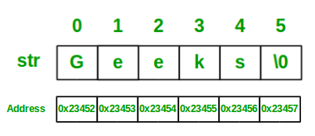
Memory Representation of String

Slide 73
String Example
char str[] = "Geeks";
cout << str;
// Declare and initialize the string
string str1 = "Welcome to GeeksforGeeks!";
// Initialization by raw string
string str2("A Computer Science Portal");
// Print string
cout << str1 << endl << str2;

